Slide 1
Introduction to Inelastic Neutron Scattering and Horace
Notes:
1

Slide 2
Inelastic neutron scattering
Why?
Material properties depend on their structure
But, atoms are not stationary
Dynamics also important → inelastic neutron scattering can measure the dynamics of atom and spins.
Notes:
2
Inelastic neutron scattering measures

Slide 3
Phonons
Phonons are quantised lattice vibrations
Can be treated as collective motions of particles (mass m) connected by springs with force constant C
Simplest case of a monatomic chain:
With solutions:
Giving a dispersion relation:

Slide 4
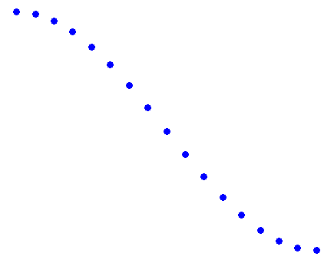
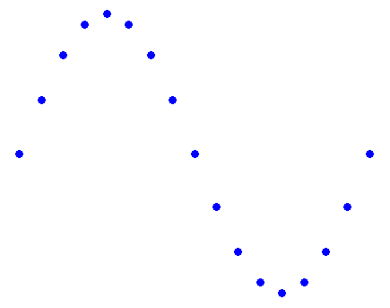
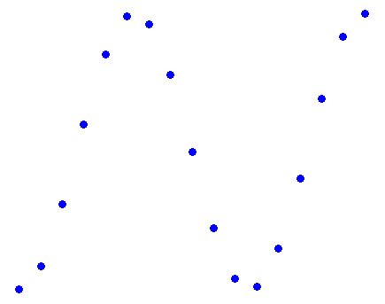
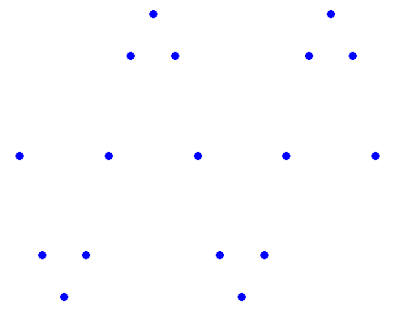
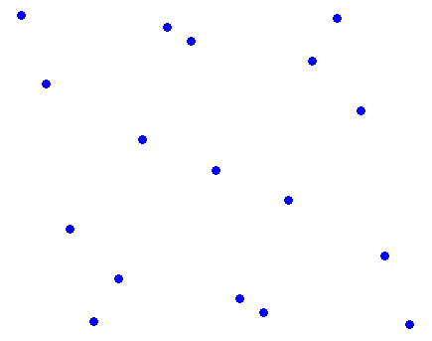

Phonons
Phonons
Transverse Acoustic Phonons
ħω
q (π/a)
0 0.2 0.4 0.6 0.8 1.0
Longitudinal
Phonons

Slide 5
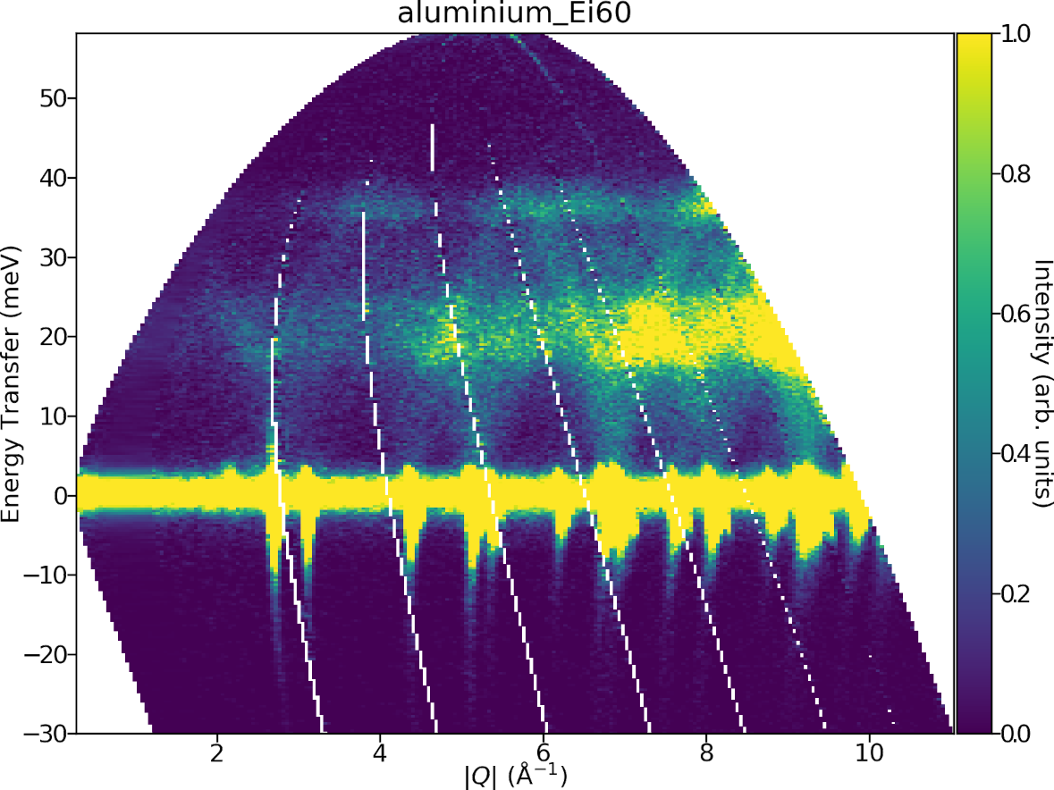
Phonons
Phonons
What does an INS phonon spectra look like?
See that there is much more intensity at high |Q| than low.

Slide 6
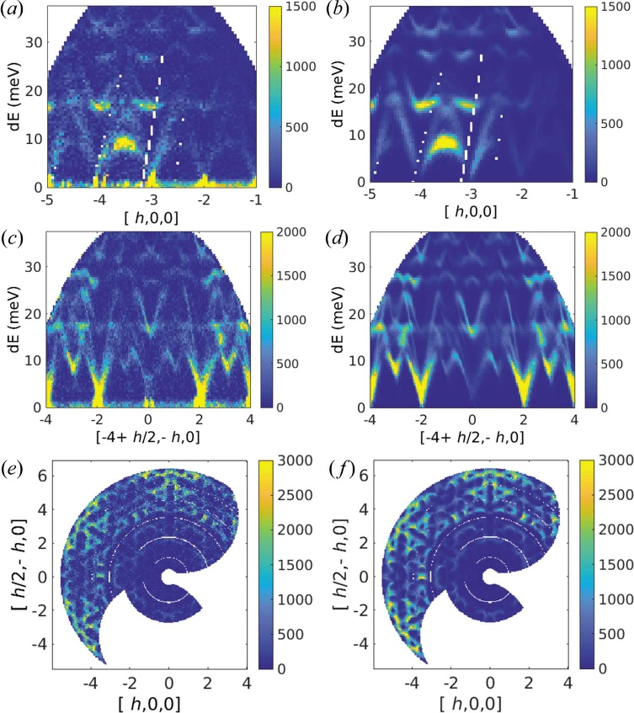
Phonons
Phonons
What does an INS phonon spectra look like?
See that there is much more intensity at high |Q| than low.
Quartz

Slide 7
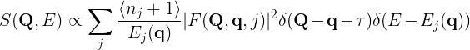
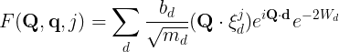
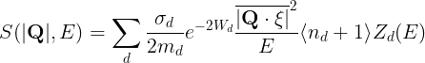
Phonons
The dynamical structure factor for phonon scattering is:
In a powder or polycrystalline sample, we have to average over all the directions of the momentum transfer Q.
At large |Q|>>|q| for a given |Q| the angular average is also approximately an average over a Brillouin zone so the term disappears and the . term can be replaced by the density of states Z(E), giving:
This is called the incoherent approximation.
Phonon dynamic structure factor
Polarization vector of mode d
Polarization factor
Debye Waller factor
Methods of experimental physics: Neutron scattering Pt A by Sköld and Price, Ch 1

Slide 8
Phonons
Phonons
Often though, the term is approximated as Q², but this is strictly only valid for single-component systems.
But the take home message here is the neutron intensity of phonon scattering increases with increasing Q.

Slide 9
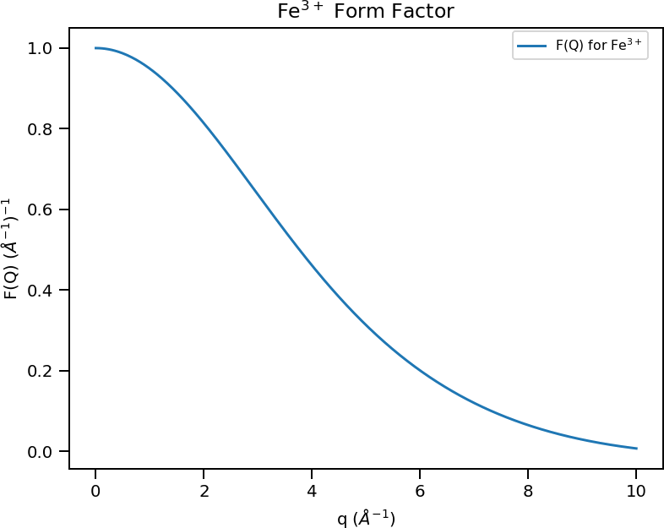
Magnetic Inelastic Scattering
Due to the magnetic dipolar interaction between the neutron moment and electronic spins.
Scattering function for magnetic neutron scattering is:
M⊥ factor
Magnetic Form Factor
Magnetic form factor is highest at low Q:
Because the electronic spins have a finite extent so their Fourier Transform is concentrated at low Q.
For phonons, scattering is due to the neutron-nucleus interaction, and nuclei are point particles compared to atoms
Magnetic excitations are most intense at low Q, opposite to phonon scattering.
Methods of experimental physics: Neutron scattering Pt A by Sköld and Price, Ch 1

Slide 10
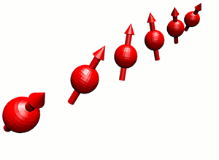
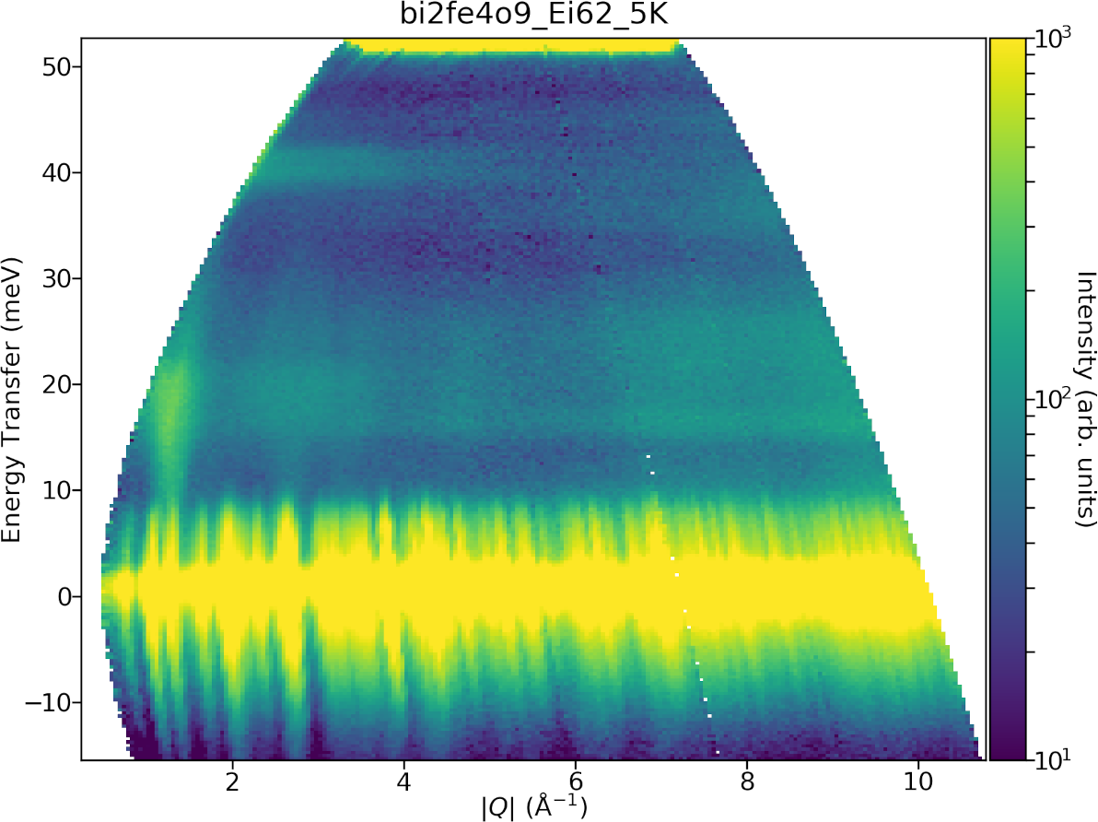
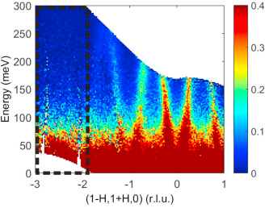
Spin waves
Quantised collective precession of spins – small deviations from ordered magnetic state
Dispersive, can look like phonons
But, most intense at low Q.
Unlike X-rays, magnetic intensity for neutrons can be larger than lattice vibrations.
Can be modelled using linear spin wave theory with SpinW in later part of course.

Slide 11
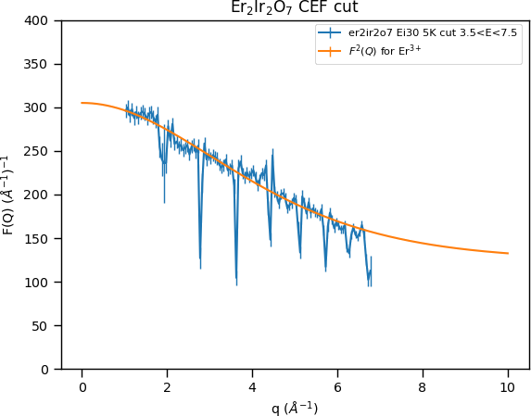
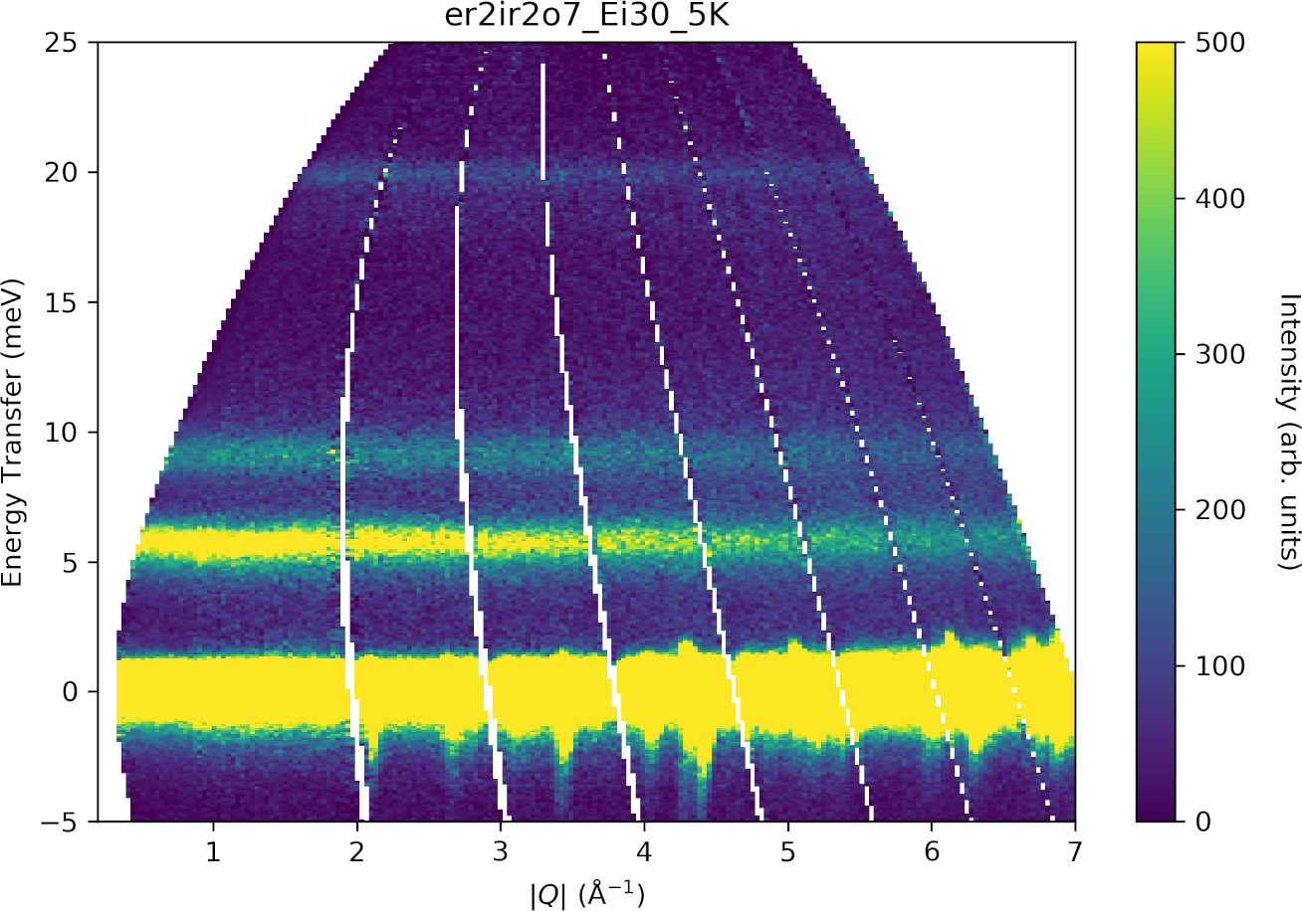
Crystal Fields
Transitions between localised electronic states with different J_{z} or L_{z} quantum number excited on a particular magnetic ion excited by neutrons.
Dispersionless, but follow form factor.
Will be covered on Day 10 practical.

Slide 12
Questions so far?

Slide 13
Experiments
How do we measure inelastic neutron spectra?
Types of spectrometers:
Triple-axis spectrometers at continuous neutron sources (e.g. reactors)
Time-of-flight spectrometers at pulsed and continuous sources
Types of samples:
Single crystal
Powders

Slide 14
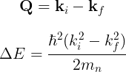
Inelastic neutron scattering
In elastic scattering, need to satisfy Bragg condition
Can be represented in an Ewald construction (sphere)
For inelastic scattering, |k_{i}| ≠ |k_{f}|
Now, have Q = k_{i} – k_{f} which defines the scattering triangle.
Ewald’s sphere
G
k_{f}
k_{i}
k_{i}
Q
k_{f}
G
k_{i}
k_{i}
Notes:
14
Inelastic neutron scattering measures

Slide 15
Triple Axis Spectrometer
The scattering triangle can be mapped directly to the axes of a 3-axis spectrometer
(k_{i} and k_{f} determined by Bragg diffraction from crystals)
A6
A5
q₁
Q
k_{f}
k_{f}
A2
A4
A1
k_{i}
k_{i}
k_{i}
q₂
A3

Slide 16
Triple Axis Spectrometer
The scattering triangle can be mapped directly to the axes of a 3-axis spectrometer
(k_{i} and k_{f} determined by Bragg diffraction from crystals)
Rotating crystal effectively rotates the scattering triangle.
A6
A5
k_{f}
q₁
Q
k_{f}
A2
A4
A1
k_{i}
k_{i}
k_{i}
A3
q₂

Slide 17
Powder INS
When we have a powder / polycrystalline sample, we have a random orientation of crystallites:
So the effectively we’re measuring an average over spherical shell of radius |Q|:
Q
k_{f}
k_{i}
k_{i}

Slide 18
Powder INS
When we have a powder / polycrystalline sample, we have a random orientation of crystallites:
So the effectively we’re measuring an average over spherical shell of radius |Q|:
Q
k_{f}
k_{i}
k_{i}

Slide 19
Powder INS
When we have a powder / polycrystalline sample, we have a random orientation of crystallites:
So the effectively we’re measuring an average over spherical shell of radius |Q|:
Q
k_{f}
k_{i}
k_{i}

Slide 20
Powder INS
When we have a powder / polycrystalline sample, we have a random orientation of crystallites:
So the effectively we’re measuring an average over spherical shell of radius |Q|:
Q
k_{f}
k_{i}
k_{i}

Slide 21
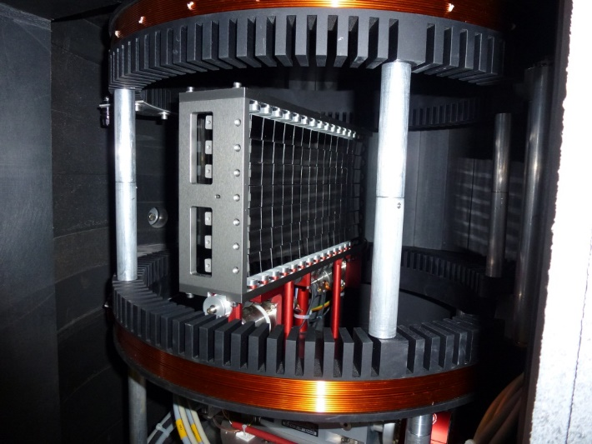
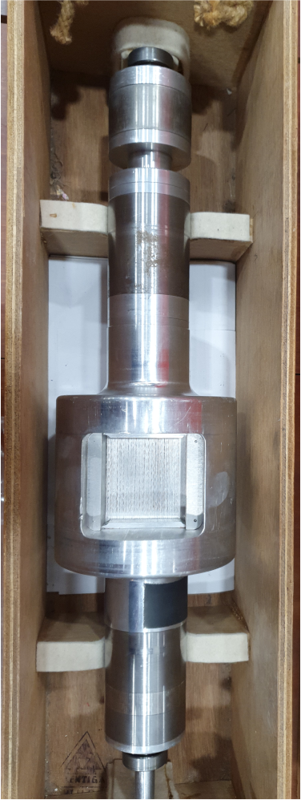
Instruments
Need a way to define the incident and/or scattered neutron energies (k_{i} or k_{f} ).
At continuous sources, need to use Bragg diffraction from crystals.
At time-of-flight sources,
can use crystals or
mechanical choppers:

Slide 22
Instruments
At a continuous source (e.g. reactor), with a 3-axis spectrometer, need to define both k_{i} and k_{f}
A6
A5
q₁
k_{f}
A2
A4
A1
k_{i}
q₂
A3

Slide 23
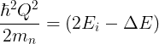

Instruments
At time-of-flight sources, only need to define one of k_{i} or k_{f} , the other is determined by the detector position and neutron time-of-flight.
“Direct geometry”: Fix k_{i}
“Indirect geometry”: Fix k_{f}
Q
k_{f}
k_{f}
k_{i}
Direct geometry

Slide 24
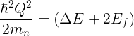
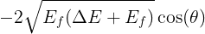
Instruments
At time-of-flight sources, only need to define one of k_{i} or k_{f} , the other is determined by the detector position and neutron time-of-flight.
“Direct geometry”: Fix k_{i}
“Indirect geometry”: Fix k_{f}
Q
k_{f}
k_{i}
k_{i}
Indirect geometry

Slide 25
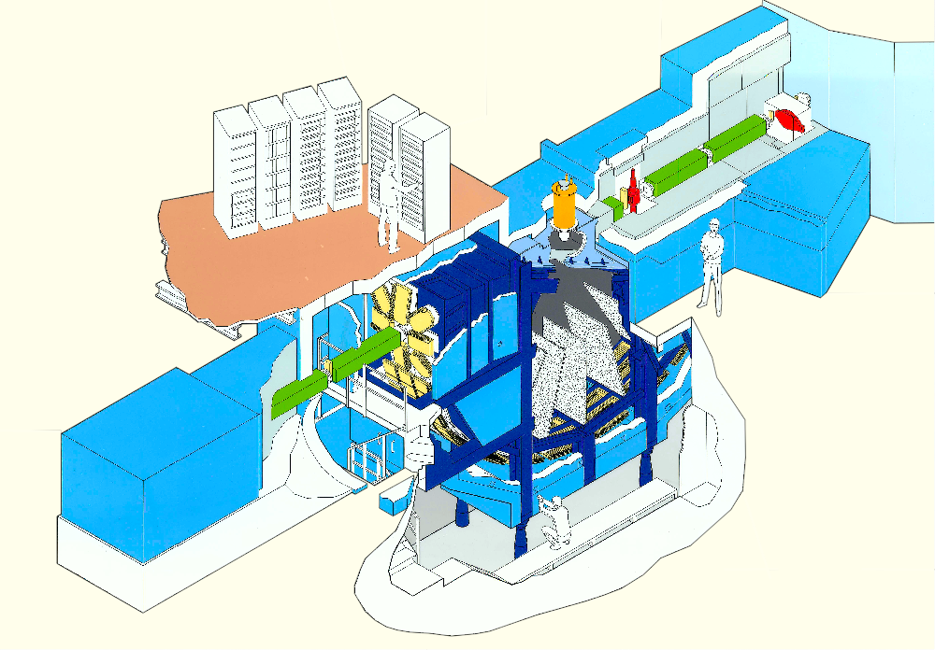
MARI
Direct Geometry Instruments
Spec
Ei = 7 meV to 1 eV
922 ³He tubes; 3° to 130°
ΔE/Ei = 2.5 - 5%

Slide 26
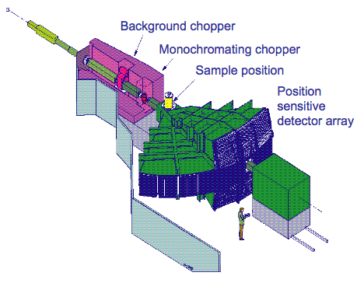
MAPS
Direct Geometry Instruments
Spec
Ei = 40 meV to 2 eV
40000 ³He PSD elements; 3° to 20° - main bank 20° to 60° - high angle bank
ΔE/Ei = 1 - 5%

Slide 27
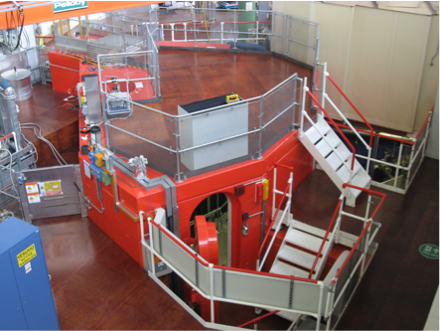
MERLIN
Direct Geometry Instruments
Spec
Ei = 10 meV to 2 eV
π steradians of ³He PSDs
(gapless)
x20 Maps flux
x7 Maps detector coverage
ΔE/Ei = 4 - 6%

Slide 28
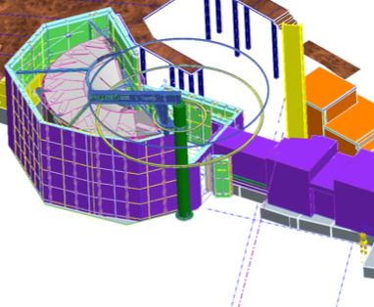
LET
Direct Geometry Instruments
Spec
Ei = 0.5 meV to 20 meV
π steradians of ³He PSDs
(gapless)
Same flux/coverage as Merlin
ΔE/Ei = 0.6 - 3.5%

Slide 29
Instrument suite
Direct Geometry Instruments
E_{i} (meV)
MAPS
MARI
MERLIN
(Flux)
LET
Q (Å)

Slide 30
Around the world
Direct Geometry Instruments
ISIS | LET | MAPS | MERLIN
ILL | IN5 | - | IN4
SNS | CNCS | SEQUOIA | ARCS
J-Parc | Amateras | HRC | 4Seasons

Slide 31
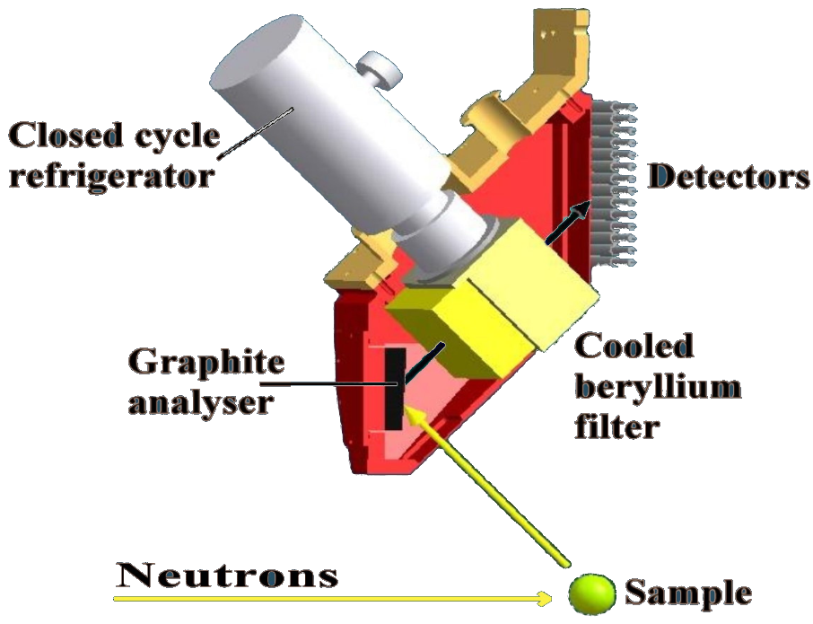
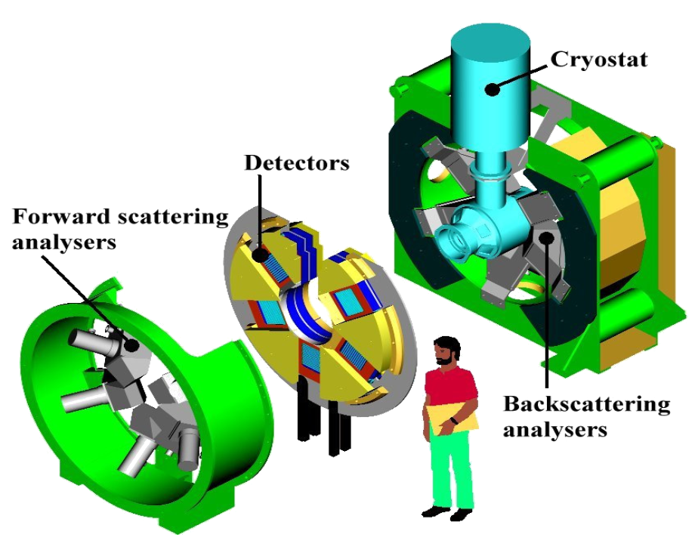
TOSCA
Indirect Geometry Instruments
Spec
Water moderator
E = 0~600 meV
ΔE/E = 1%
(energy transfer)
Detectors only around:
40-55° (forward)
125-140° (back)
n

Slide 32
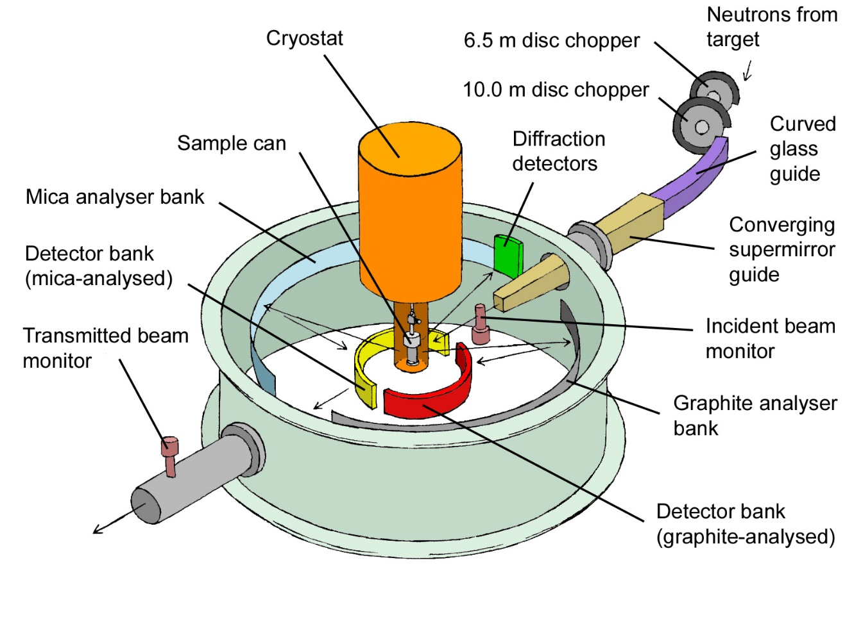
IRIS
Indirect Geometry Instruments
Spec
Hydrogen moderator
E < 4 meV
ΔE ~ 18µeV (PG)
High flux
Detectors 25<2θ<160°

Slide 33
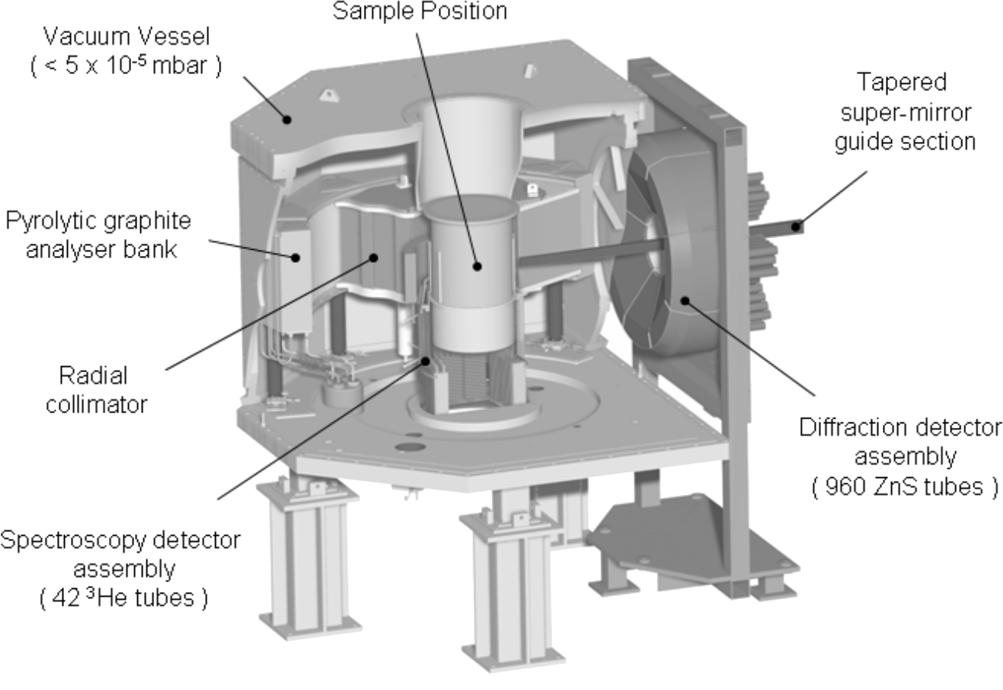
OSIRIS
Indirect Geometry Instruments
Spec
Hydrogen moderator
E < 4 meV
ΔE ~ 25µeV (PG)
Very high flux
Detectors 11<2θ<148°

Slide 34
Around the world
Indirect Geometry Instruments
ISIS | TOSCA | IRIS/OSIRIS
SNS | VISION | BASIS
J-Parc |  | DNA

Slide 35
Questions so far?

Slide 36
Sample Rotation
What happens when we rotate the sample?
Recap: rotating the sample (lattice) is equivalent to rotating the scattering triangle:
Q
k_{f}
k_{i}
k_{i}

Slide 37
Sample Rotation
What happens when we rotate the sample?
Recap: rotating the sample (lattice) is equivalent to rotating the scattering triangle:
Q
k_{f}
k_{i}
k_{i}

Slide 38
Sample Rotation
What happens when we rotate the sample?
Recap: rotating the sample (lattice) is equivalent to rotating the scattering triangle:
→ In a single crystal, rotating the sample is equivalent to rotating the detector surface in (Q,ω)-space
Q
k_{f}
k_{i}
k_{i}

Slide 39
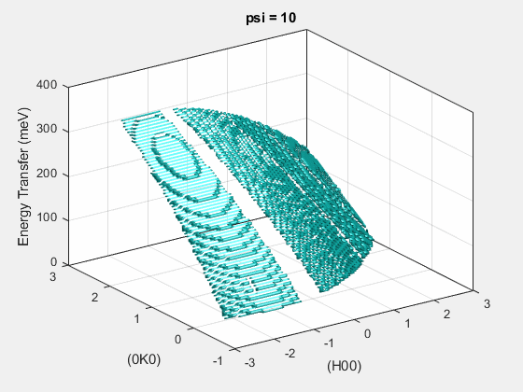
Sample Rotation
In a single crystal, rotating the sample is equivalent to rotating the detector surface in (Q,ω)-space

Slide 40
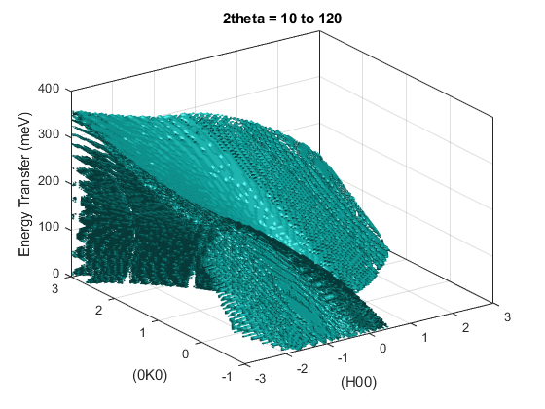
Sample Rotation
By rotating the sample by small angles, we can combine the different detector surfaces cutting through (Q,ω)-space into a single 4D dataset.
This is what Horace does.

Slide 41
Horace
Horace is used for 3 main tasks:
Creating a 4D S(Q,ω) dataset (an “.sqw” file) from a set of runs at different sample rotation angles
Viewing / plotting this data in particular (Q,ω) regions
Fitting the data (either using a model for the scattering or to simple peak functions)
Horace is mostly a command-line driven program in Matlab.
There is a GUI which can do all of these tasks, but represents only about ≈70% of the functionality of Horace.
The next sections will give an overview of how the program works and what it can do
Ewings et al., Nucl. Inst. Meth. Phys. Res. A, 834 (2016) 132

Slide 42
Generating the 4D sqw file
The data stored in the 4D sqw file is stored in chunks in a coarse regular grid in (Q,ω)-space.
This allows fast access when you want to view a specific (Q,ω) region (just that chunk needs to be read).
But it means that Horace needs to know the full angular range of a scan in order to determine the (Q,ω)-grid.
(e.g. you have to give the full ψ rotation range when you generate the sqw file)
Horace is designed to run in parallel on both shared memory systems and clusters but it can also run on your laptop!
The bottleneck is usually disk-access speeds
Ewings et al., Nucl. Inst. Meth. Phys. Res. A, 834 (2016) 132

Slide 43
Generating the 4D sqw file
To generate the 4D sqw file, you need to give Horace:
The lattice parameters
The incident energy E_{i}
The crystal orientation
Specified as 2 vectors: u and v which define the horizontal plane
A set of angles ψ (psi) where ψ=0 corresponds to u||k_{i}. (u parallel to the incident beam), corresponding to all the measurements made (or planned).
Offset angles (dψ [dpsi], Ω [omega], GU, GL) denoting crystal mis-alignments.
GU
u
Ω
n
ψ
GL
v
Ewings et al., Nucl. Inst. Meth. Phys. Res. A, 834 (2016) 132

Slide 44
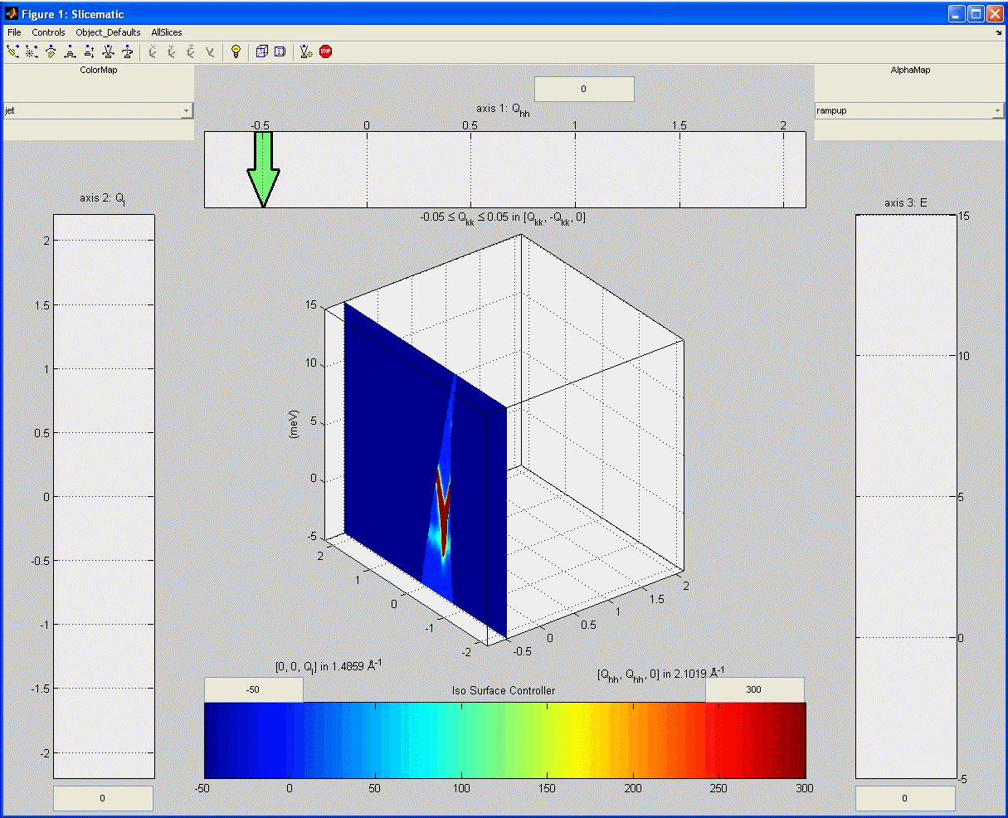

View data
Horace can plot 1D, 2D, 3D sections (“cuts”) of the data:
RbMnF₃, Ewings et al., Nucl. Inst. Meth. Phys. Res. A, 834 (2016) 132

Slide 45
View data
Horace can plot 1D, 2D, 3D sections (“cuts”) of the data:
ε = 6 meV
RbMnF₃, Ewings et al., Nucl. Inst. Meth. Phys. Res. A, 834 (2016) 132

Slide 46
Horace Data Types
When you use Horace to take a section from the sqw file (“make a cut”) you can create two types of objects:
dnd (d1d, d2d, d3d, d4d) objects contain only histogrammed (binned) data
sqw objects contains both histogrammed data which can be plotted and all the detector-energy elements (“pixels”) which were rebinned.
sqw objects are created by default but take up a lot of memory.
dnd objects are created with the '-nopix' flag.
Certain operations (smooth, replicate) only work with dnd objects
Other operations (resolution convolution, symmetrisation, re-rebin) only work with sqw objects
Ewings et al., Nucl. Inst. Meth. Phys. Res. A, 834 (2016) 132

Slide 47
Questions so far?

Slide 48
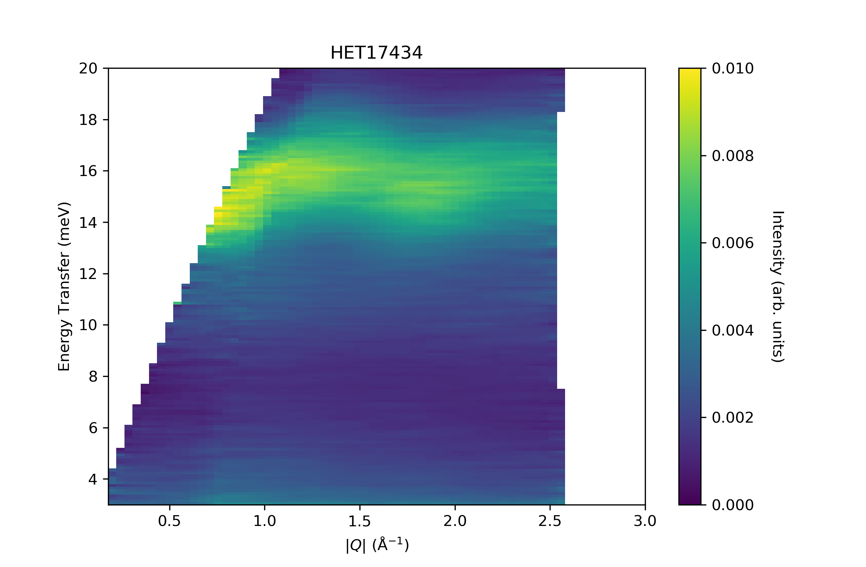
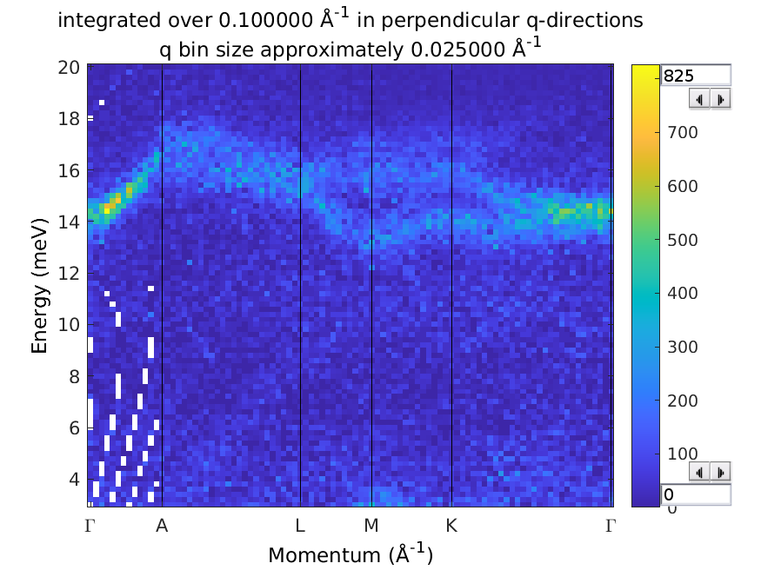
Single Crystal INS
Why measure excitations in single crystals?
In powder (polycrystalline) measurements can only measure the magnitude of momentum transfer |Q|
Directional information is lost.
With single crystal, can see the full dispersion surfaces ω(Q)
UPd₃
Notes:
48
Inelastic neutron scattering measures

Slide 49
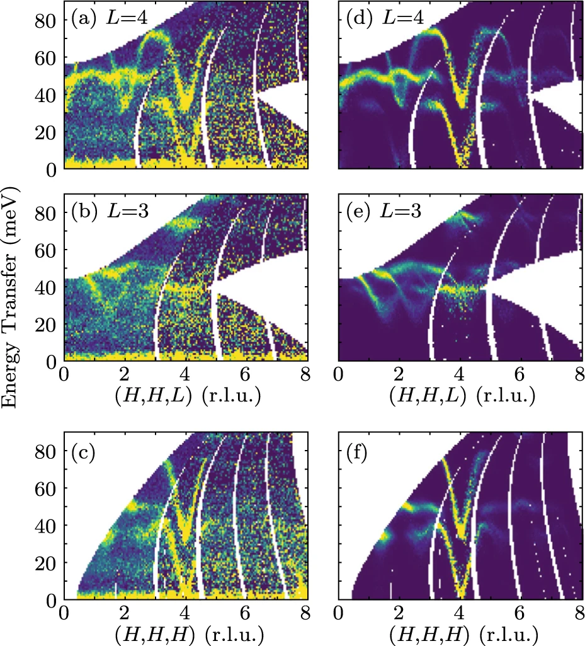
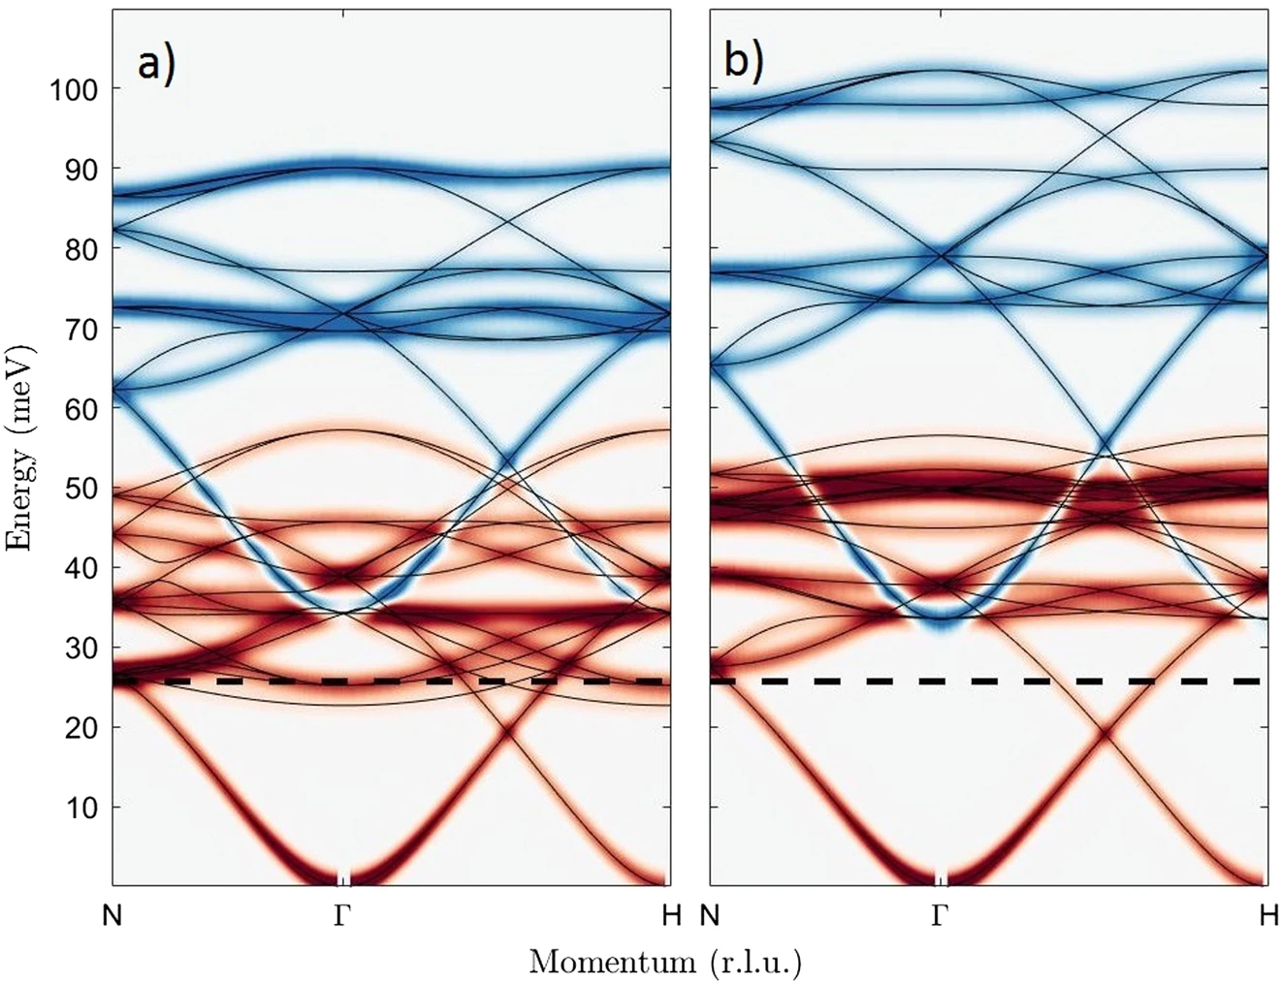
Single Crystal INS
The advantage of direct-geometry ToF spectrometers is the large Q-coverage – can measure several full Brillouin zones.
This allows e.g. a very detailed look at the dispersion giving much more accurate exchange parameters.
Old Model
New Model
Yttrium Iron Garnet, Princep et al., npj Q. Mater., 2 (2017) 63
Notes:
49
Inelastic neutron scattering measures

Slide 50
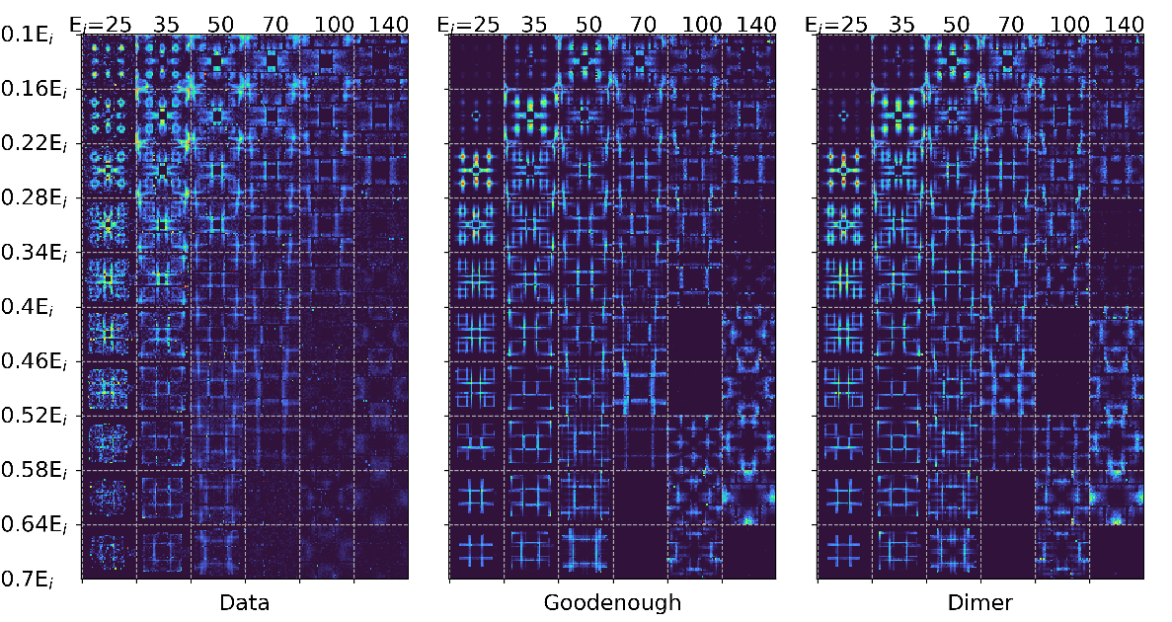
Single Crystal INS
Or the large Q-coverage can allow you find a particular small region in Q-space which distinguishes between two models, which is not a priori obvious.
Pr(Ca,Sr)Mn₂O₇, Butler et al., J. Phys.: Condens. Matter, 33 (2021) 194006
Johnstone et al., Phys. Rev. Lett., 109 (2012) 237202
Notes:
50
Inelastic neutron scattering measures

Slide 51
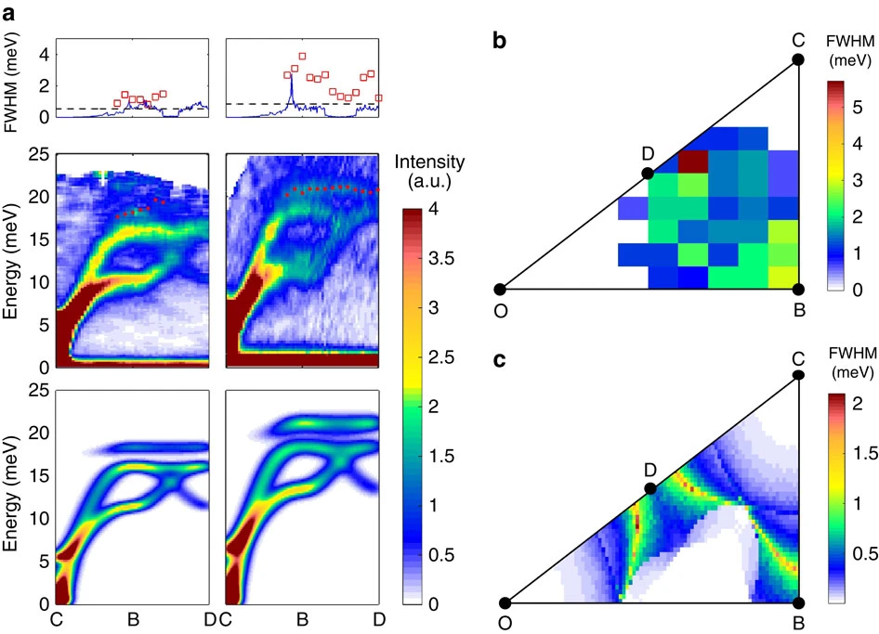
Single Crystal INS
Finally, the large Q-coverage is useful if you want to measure diffuse inelastic scattering.
Data
Model
Magnon lifetime broadening in (Y,Lu)MnO₃, Oh et al., Nat. Comm., 7 (2016) 13146
Notes:
51
Inelastic neutron scattering measures

Slide 52
Single Crystal INS
In contrast, there are some situations where you don’t need to use a direct-ToF spectrometer with large Q-coverage or full rotation scan
When you want to focus on a specific Q,ω region and want to measure a change with T, P, H, etc. → use a triple-axis spectrometer
If you have a low-dimensional magnetic material where the dispersion is only along one (or two) directions – choosing the right fixed orientation of the detector surface can be enough.
Notes:
52
Inelastic neutron scattering measures

Slide 53
Questions so far?

Slide 54
Summary
INS can be visualised using the scattering triangle.
In continuous sources (reactors), need to define both the incident and scattered neutron energy / wavevector (k_{i} and k_{f} ).
In time-of-flight INS, only need to define either k_{i} or k_{f} and use the ToF to infer the other.
ToF where k_{i} is fixed is direct geometry.
ToF where k_{f} is fixed is indirect geometry.
There are different kinematic trajectories for each case.

Slide 55
Summary
Phonons are quantised lattice vibrations (collective motions of atoms).
Phonon INS intensity is larger at high |Q| (approximately proportional to |Q|²).
Magnons are quantised spin precessions in an ordered magnetic state.
Crystal field excitations are excitations between localised electronic states with different with different J_{z} or L_{z} quantum number.
Magnetic excitations (magnons and crystal fields) follow the magnetic form factor and have highest INS intensity at low |Q|.

Slide 56
Summary
For a given single crystal sample orientation (rotation angle), the detector banks on a direct-geometry ToF spectrometer image a 3D parabolic surface in the 4D (Q,ω) reciprocal space.
This surface changes when the crystal is rotated.
By combining multiple measurements at different rotations, a 4D S(Q,ω) dataset (an .sqw file for Horace) can be reconstructed.
These single-crystal datasets covering large (Q,ω) are useful to details of microscopic models or explore lifetime (linewidth broadening) effects.

Slide 57
Summary
Horace stores data in the sqw file sorted in a coarse regular (Q,ω) grid for fast access.
Horace has two types of data objects in memory:
dnd (d1d, d2d, d3d, d4d) objects contain only histogrammed (binned) data. Created with the '-nopix' flag.
sqw objects contains both histogrammed data which can be plotted and all the pixels which were used in the histogrammed data.

